Slide 1

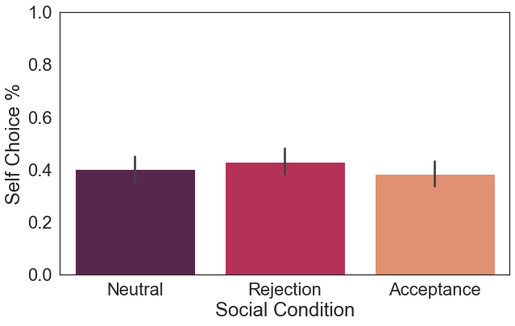
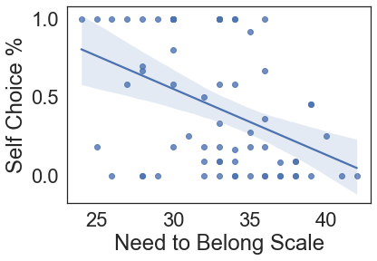
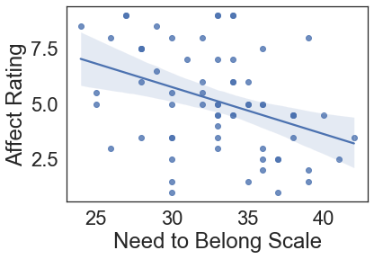
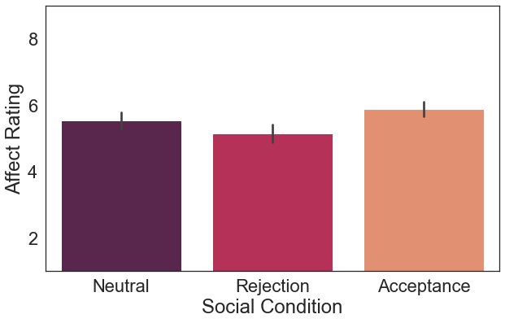
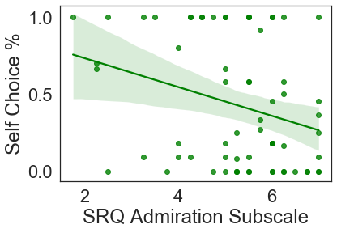
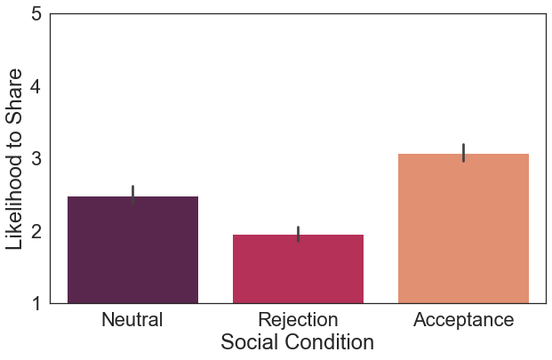

The Effect of Social Rejection on the Value of Choice
Jordan M. Dejoie¹, Melanie Ruiz¹, Emily Brudner², Sarah Gallardo¹, Carmen Lima¹, Mauricio R. Delgado² , Dominic S. Fareri¹
¹Adelphi University, ² Rutgers University-Newark
Introduction
Rejection and the Value of Choice
The Need to Belong
The benefits of social connection are widespread, fulfilling fundamental needs of belongingness and providing social support.
Conversely, experiences of social rejection and isolation are associated with a host of negative physical and mental health consequences, and the social media boom allows for myriad new opportunities for social rejection to occur.
Given the prevalence of rejection and the recently declared loneliness epidemic, understanding the effects of rejection on everyday behavior is critical.
Yet, the ways in which rejection may impact cognitive processes, such as choice, more generally remain understudied.
Goal & Hypothesis
r(66) = -.41, p <.001
We sought to examine the effect of social rejection on the value of choice:’
Pre-registered Hypotheses:
H1.1: Participants will opt to choose for themselves more often following the rejection condition relative to both other conditions.
H1.2: Participants will report more negative emotions during rejection blocks relative to other conditions.
H1.3: Participants will report a decreased likelihood of sharing with ‘avatars’ who rejected their photos most often.
H1.4: Individual differences such as the need to belong, rejection sensitivity, autistic traits, etc. will moderate the relationship between rejection and choice.
F(2,132) = 1.39, p > .05, f = .002
There was not a significant overall effect of social condition on choice behavior. Participants did not demonstrate significant differences in their choice behavior across social conditions.
Affect and Rejection
r(66) = -.39, p = .001
Methods
Participants with a higher need to belong were less likely to engage in choice themselves after rejection than those with a lower need to belong. Participants with a higher need to belong also reported more negative affect following rejection.
Participants : 67 adults (18-35 yrs); (24M, mean age =27.5 yrs)
Recruited from Prolific.co
Day 1
Day 2
Social Reward and Rejection
Participants completed self-report measures:
Rejection Sensitivity Questionnaire
Social Connectedness Scale – Revised
Autism Spectrum Quotient
Social Reward Questionnaire
Need to Belong Scale
Emotion Regulation Questionnaire
Brief Resilience Coping Scale
Perceived Stress Scale
Reward Responsiveness Scale
Dickman Impulsivity Inventory
Drug Abuse Screening Test
Multidimensional Scale of Social Support
Liebowitz Social Anxiety Scale
Photo Upload:
Participants uploaded 32 of their own Instagram photos including a brief caption, # of likes received, and how they feel about photo.
Experimental Task (adapted from Brudner et al., 2022).
Participants share personal photos and receive feedback on those photos from 5 partners.
Partners provided either 70% negative feedback (rejection x2), 50% negative feedback (neutral), or 30% negative feedback (acceptance x2).
Intermittently, participants were presented with the opportunity to play a lottery for a monetary bonus. Participants were asked if they wanted to play the lottery for themselves or have the computer play on their behalf.
Participants rated their affect and their likelihood to share with each partner in the future
F(2,132) = 9.75, p < .001, f = .14
Rej v Acc: t(66) = -4.12, p < .01, d = .35
Rej v Neu: t(66) = -2.29, p < .01, d = .17
Neu v Acc: t(66) = -2.3, p < .01, d = .17
Participants reported feeling least positive following rejection and most positive following acceptance. All social conditions were significantly different from each another.
Rejection and Future Behavior
r(66) = -.26, p <.05
Participants who are more sensitive to social rewards (e.g., being flattered, receiving positive attention) were less likely to engage in choice for themselves following rejection.
Discussion
Our results demonstrate that Individual differences in sensitivity to social reward (e.g., the need to belong, sensitivity to positive feedback) may play a significant role in the way in which people value choice after experiences of rejection..
While we did not see an overall effect of social feedback on choice behavior, social feedback did modulate affect and the likelihood to interact with a partner in the future.
Future analyses will explore modulating roles of affect and individual differences in the relationship between social feedback and the value of choice.
You have matched with: Sam
This photo is now being shared
Sam liked/did not like your photo.
Or
Press space to continue,
Please wait for feedback.
f(2,132) = 43.39, p <.000, f = .49
Rej v Acc: t(66) = --9.29, p < .01, d = 1.24
Rej v Neu: t(66) = --4.59, p < .01, d = .57
Neu v Acc: t(66) = -4.74, p < .01, d = .58
3s
5s
5s
You can now play a lottery for an additional bonus. Please choose if you’d like to play for yourself or for the computer to play on your behalf.
Acknowledgments
Participants reported being least likely to want to interact in the future with partners providing more negative feedback on their photos. All social conditions were significantly different from each another.
This work was supported by funding from the National Institute of Health (R15-MH122927) and an Adelphi University Faculty Development Award.
Self
Computer
3s

